Slide 1

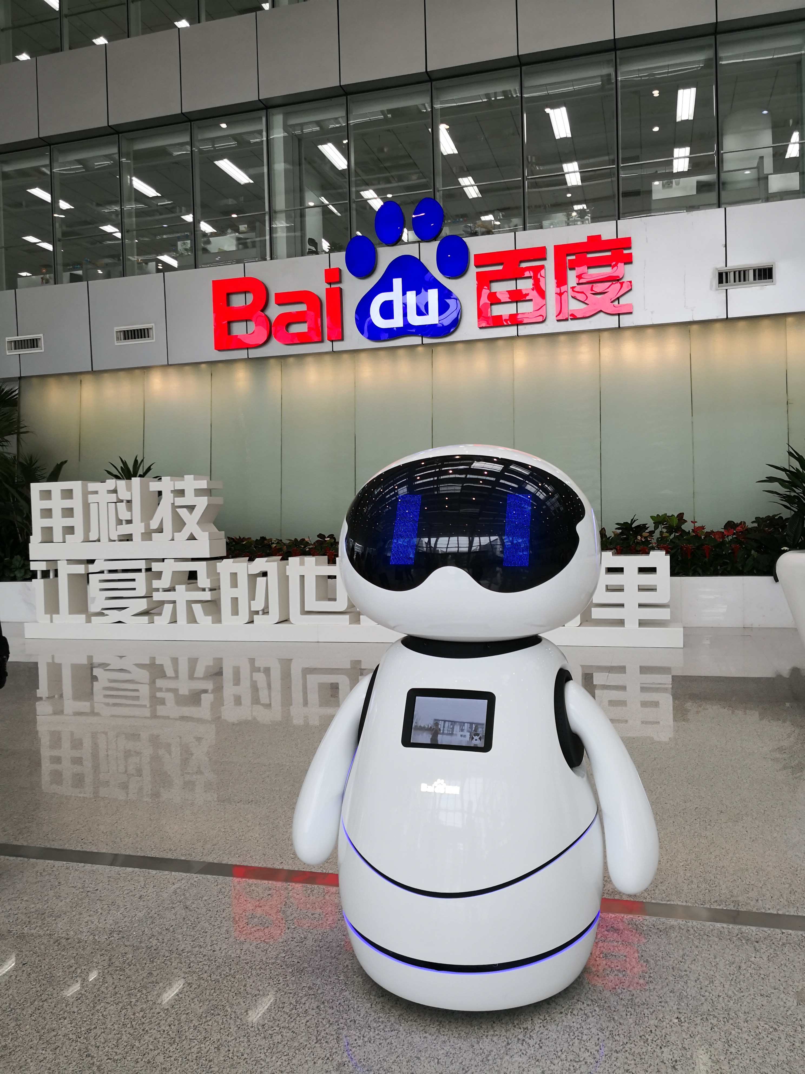
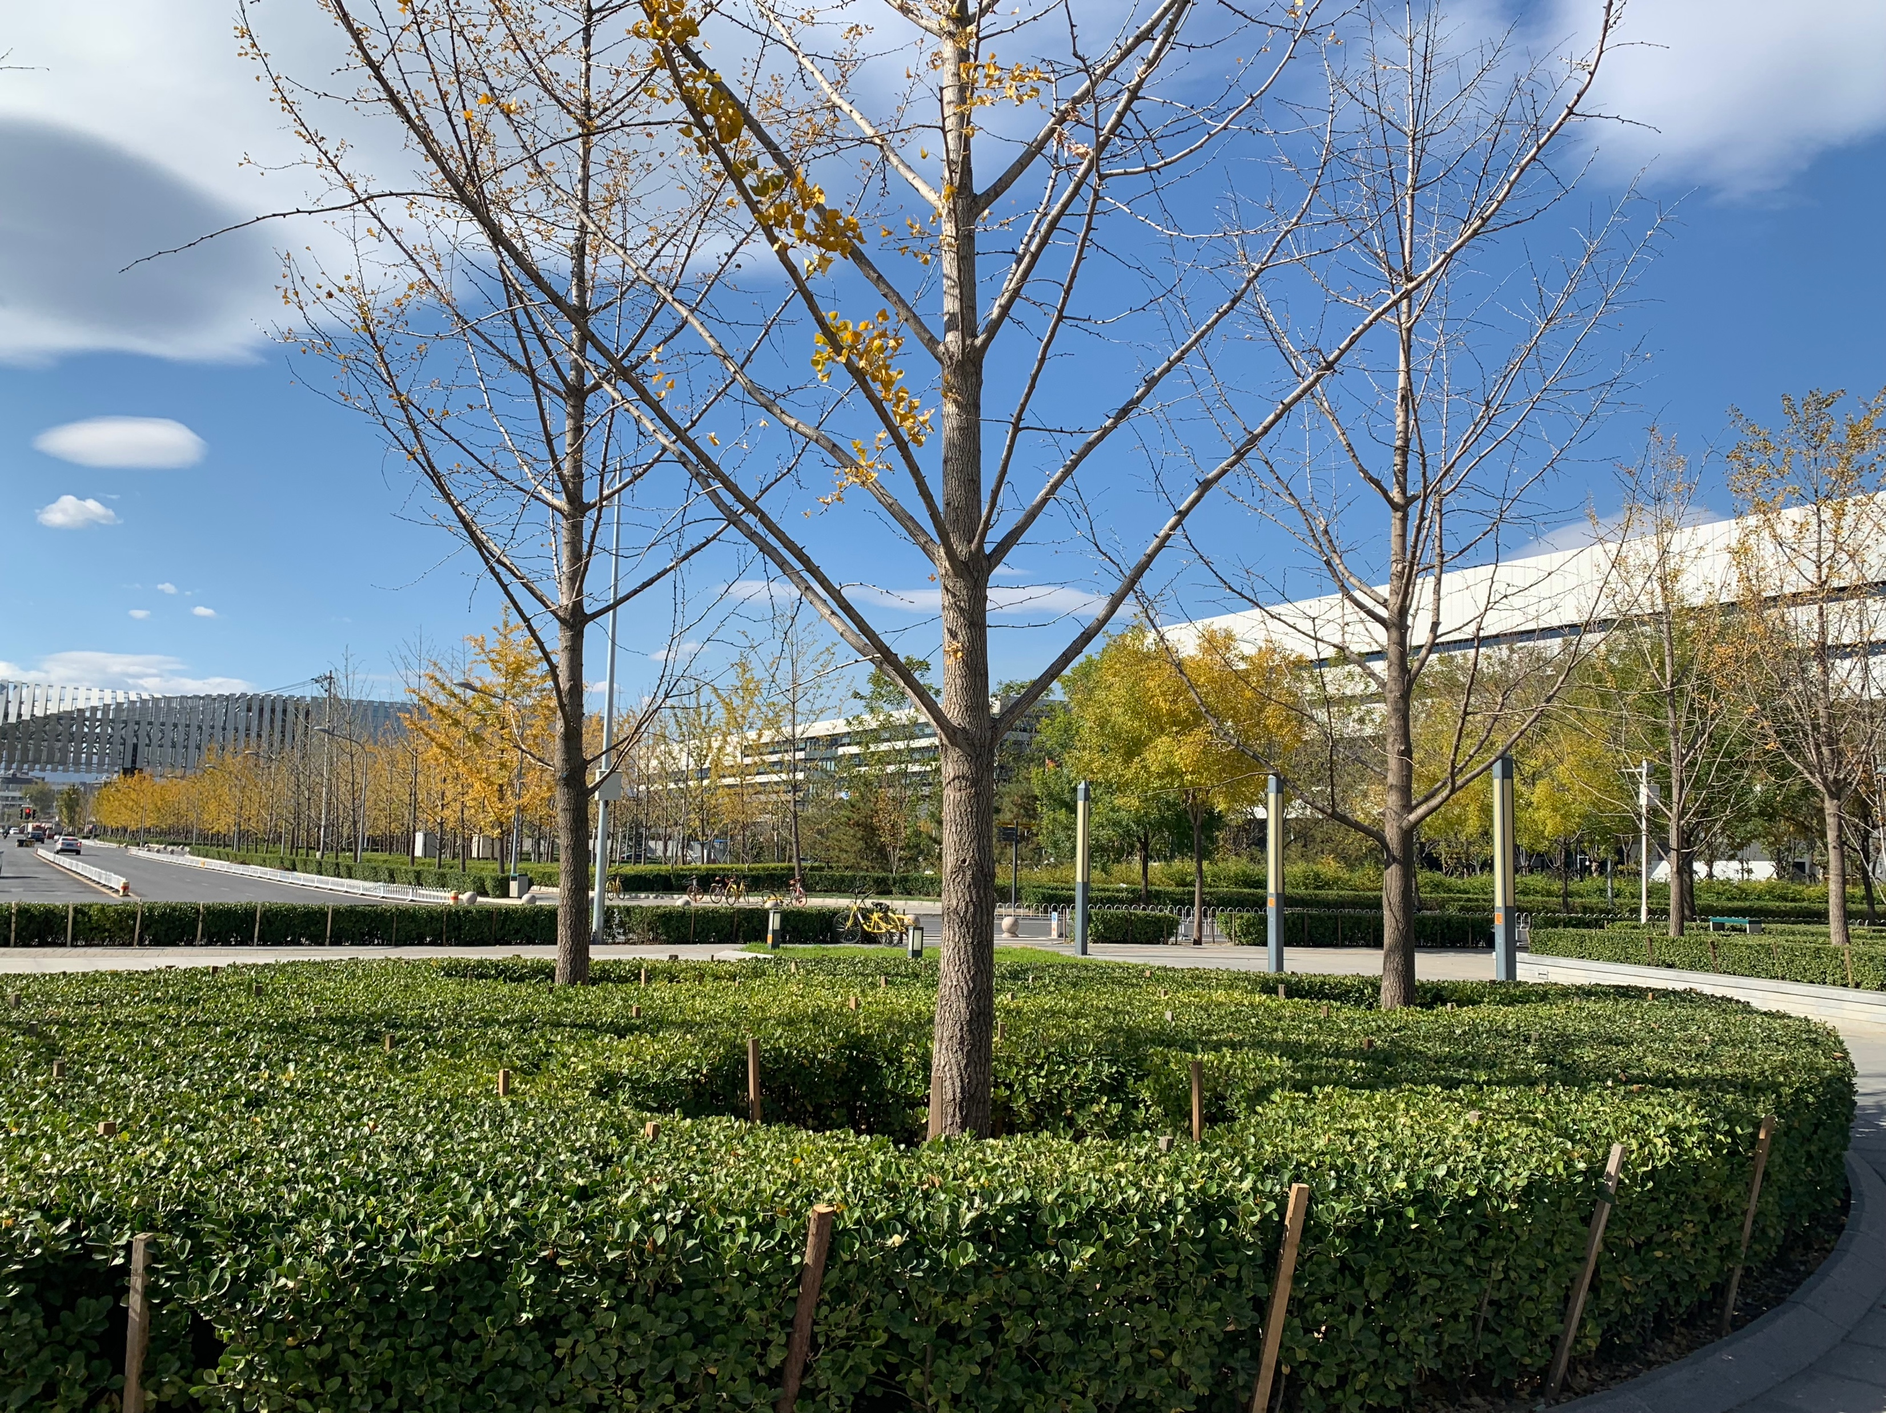
AutoDL: Transfer Learning
Xingjian Li
Big Data Lab, Baidu Research
Notes:
Good afternoon everyone, I’m Xingjian Li from Baidu research, Big Data Lab. It’s my pleasure to share with you the following part of this tutorial. My topic is on transfer learning. It is something like an overall introduction from basic concepts to typical methods. I think most of these contents are easy to understand.

Slide 2
Overview
Problem Definition
Empirical Studies
Theoretical Understandings
Novel Algorithms
Applications
Notes:
My presentation will be in following parts. First is the background and problem definition. Then I will briefly introduce recent empirical and theoretical studies. These works help us understand the success of deep transfer learning. The emphasis of this presentation is the following part of novel algorithms. I divide existing algorithms into four categories. For each category, I’ll demonstrate one or two typical works. Finally, I will briefly introduce applications of autodl transfer in baidu's products and services.

Slide 3
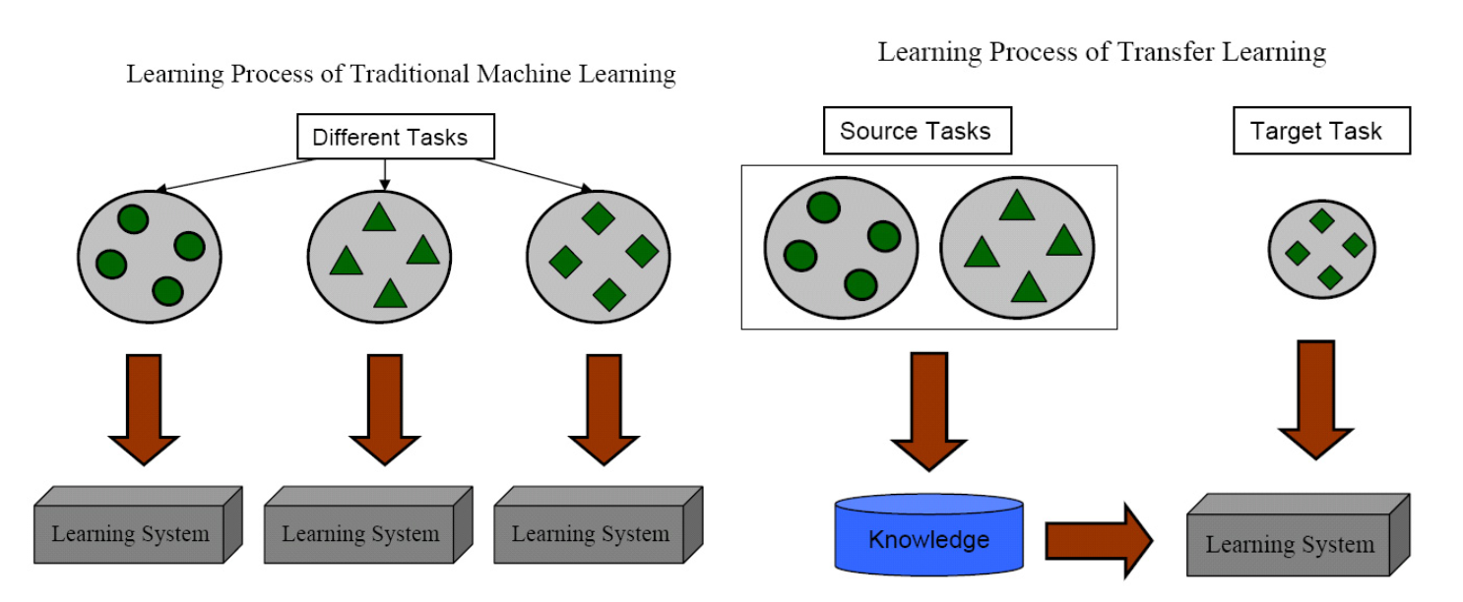
Background about Transfer Learning
Problem Background
Improve model performance when training dataset is small
Use source task to help target task
Sinno Jialin Pan, Qiang Yang, et al. A survey on transfer learning. IEEE Transactions on knowledge and data engineering, 22(10):1345– 1359, 2010.
Notes:
Begin from the background
It’s well known that.. over-fitting
the common purpose..
auxiliary called src, desired called tgt

Slide 4
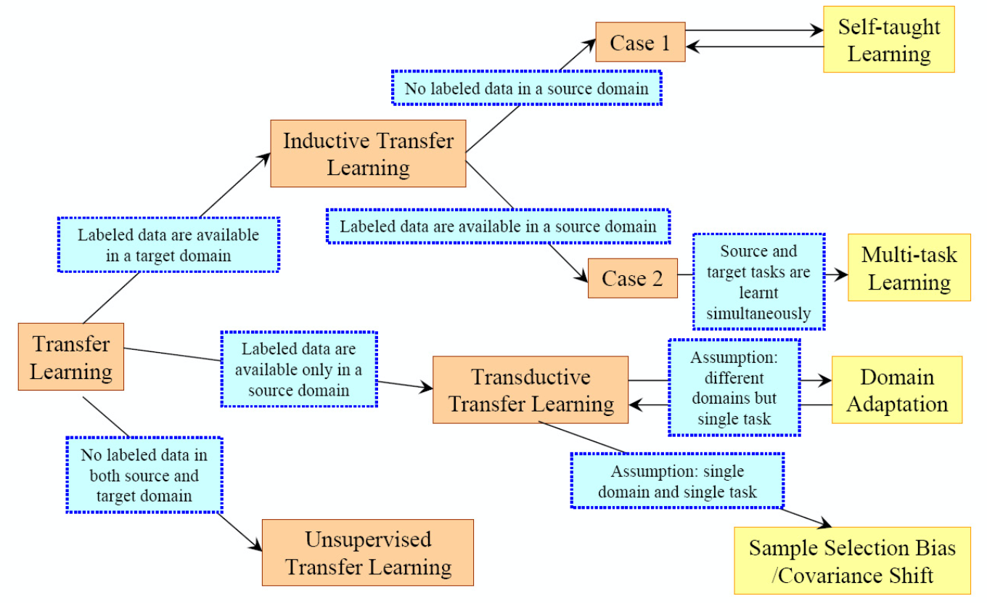
Background about Transfer Learning
Taxonomy of Transfer Learning
Sinno Jialin Pan, Qiang Yang, et al. A survey on transfer learning. IEEE Transactions on knowledge and data engineering, 22(10):1345– 1359, 2010.
Notes:
1.According to diff. divided into.., which are..
2.Inductive.. deals with..; main topic
3.for sake of simp.., use the name..for short in following parts.
4.briefly introduce the other two..
5.Transductive..cares about src tgt label.., while..
6.unsupervised..deals with transfer learning problems for unsup..tasks. So there is no labeled..

Slide 5
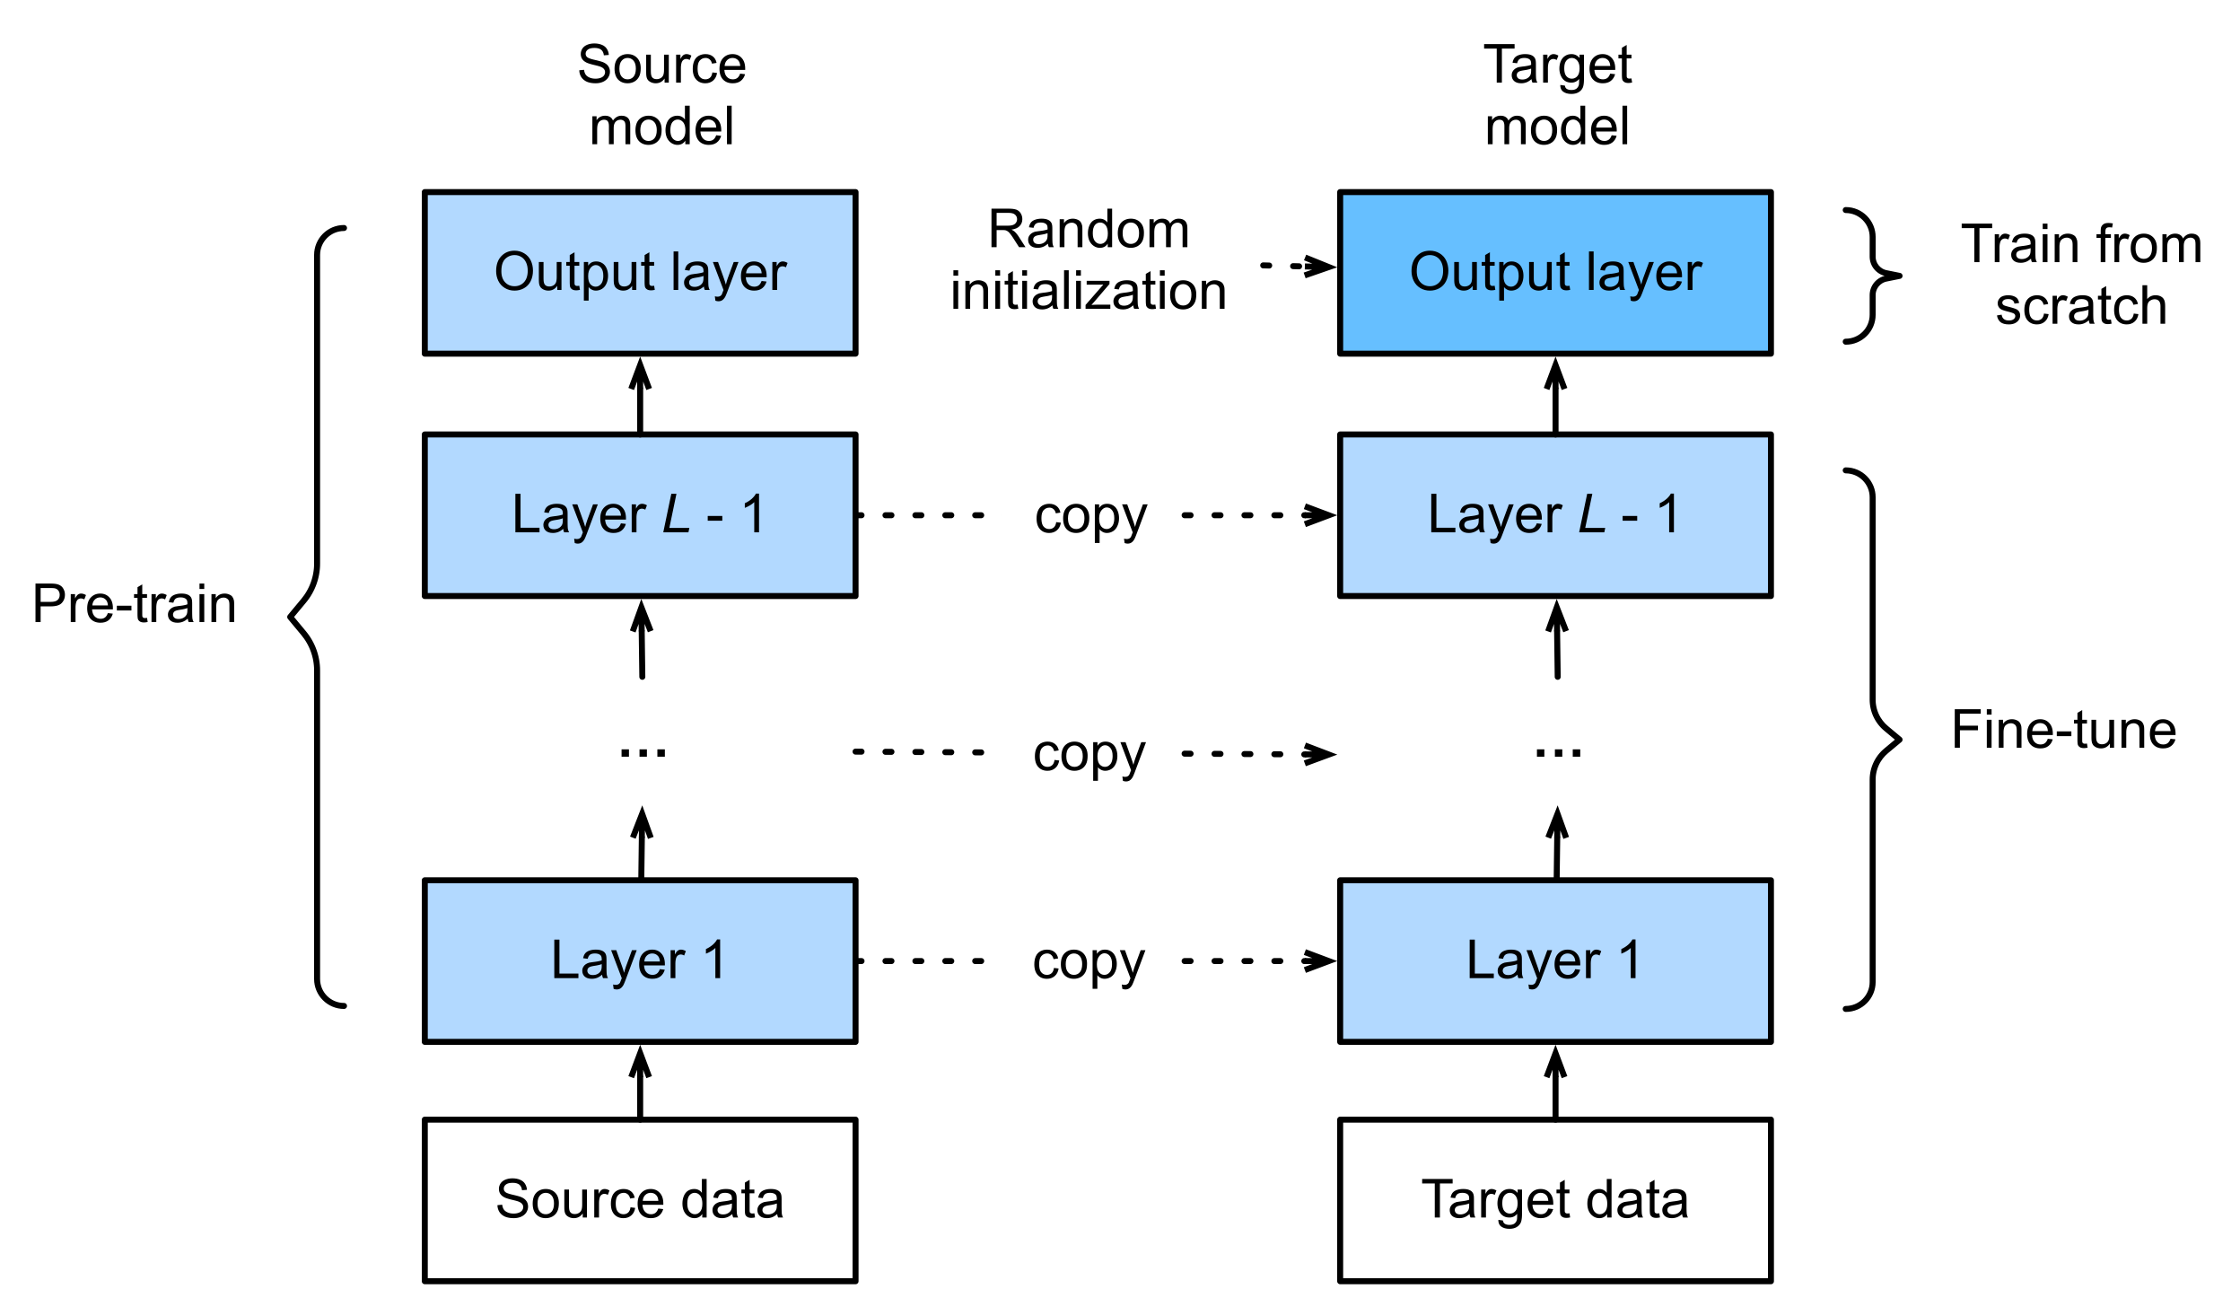
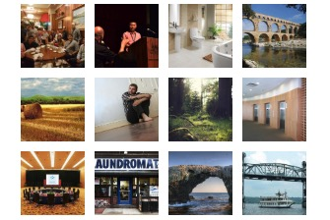
Background about Transfer Learning
Common Practice of Inductive Transfer Learning
ImageNet
Flower 102
https://d2l.ai/chapter_computer-vision/fine-tuning.html
MIT Places
MIT Indoor 67
Notes:
1.talk about common practice
[src dataset]
2.large scale open.. used as.. e.g. imagenet
3.also..for specific domains, e.g. places for scene..
[tgt task]
4. may be 100 kinds of flowers or even object detect..
[fine-tuning]
5. the most popular practice.. is two step..
6. first train on src; then create tgt; last replaced
7. second fine-tune; fix/update; SGD/smaller lr than..

Slide 6
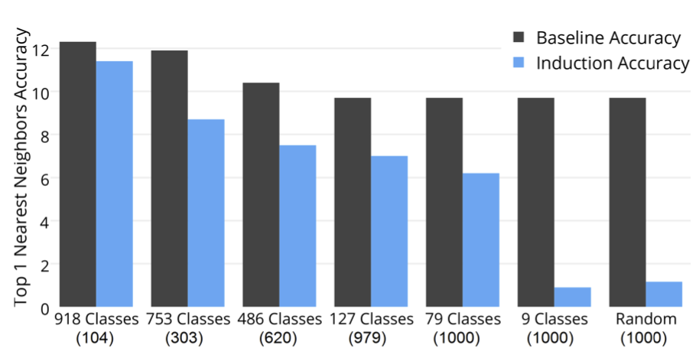
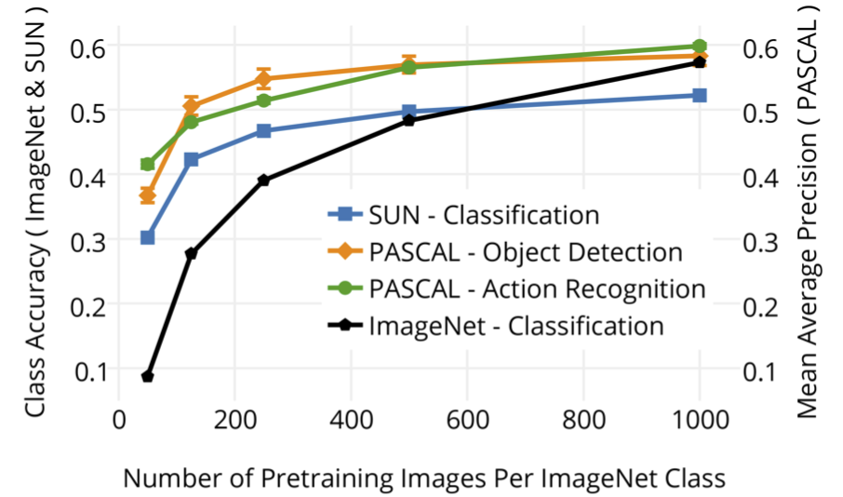
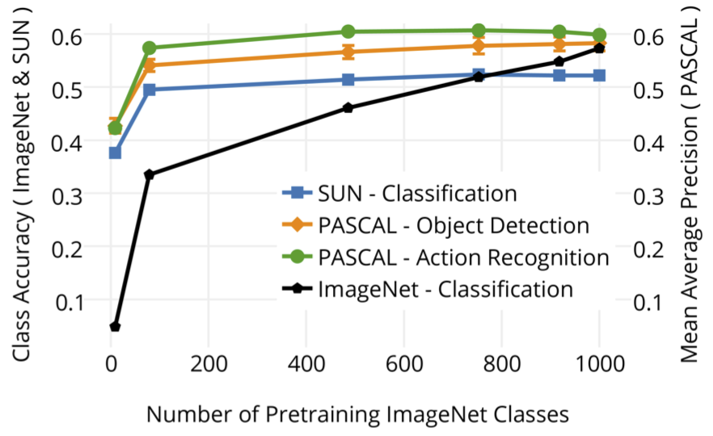
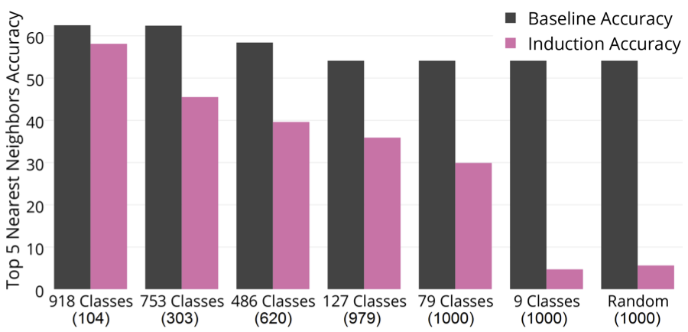
Empirical Studies - Dataset
Minyoung Huh, Pulkit Agrawal, and Alexei A Efros. What makes imagenet good for transfer learning? arXiv preprint arXiv:1608.08614, 2016.
Notes:
1.in this part show sth. intesting from aspects of..
2.one investigates why imagenet good..
3.authors conclude difficult to..; value observations
4.perf of down task not sensitive; left figure; hurts perf of imagenet; drop marginal for downst..
5.suggest not data hungry
6.get similar observation in a different setting.
e.g. experiments show..the source model pre-trained on coarse classes still gets good transferability for the target task on fine-grained classes, and vice versa.

Slide 7
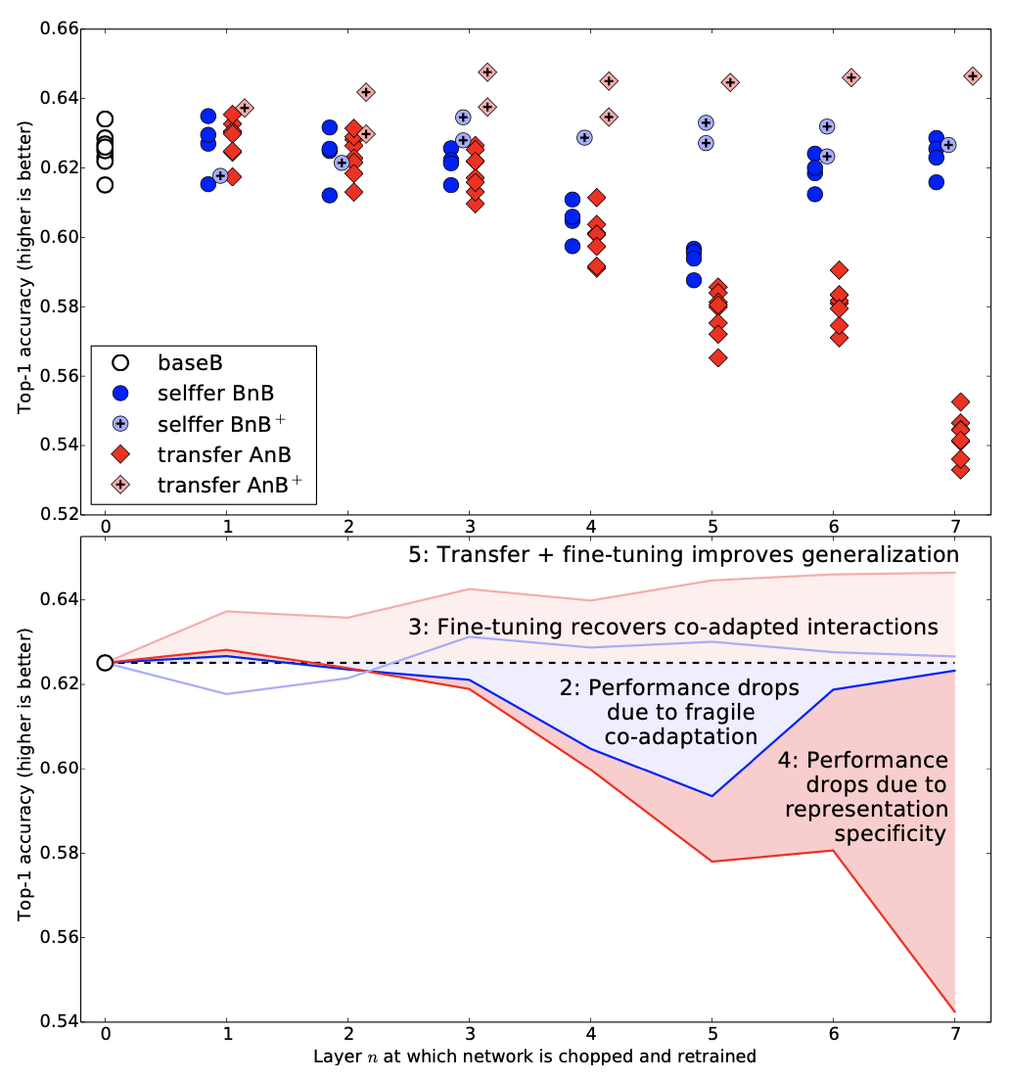
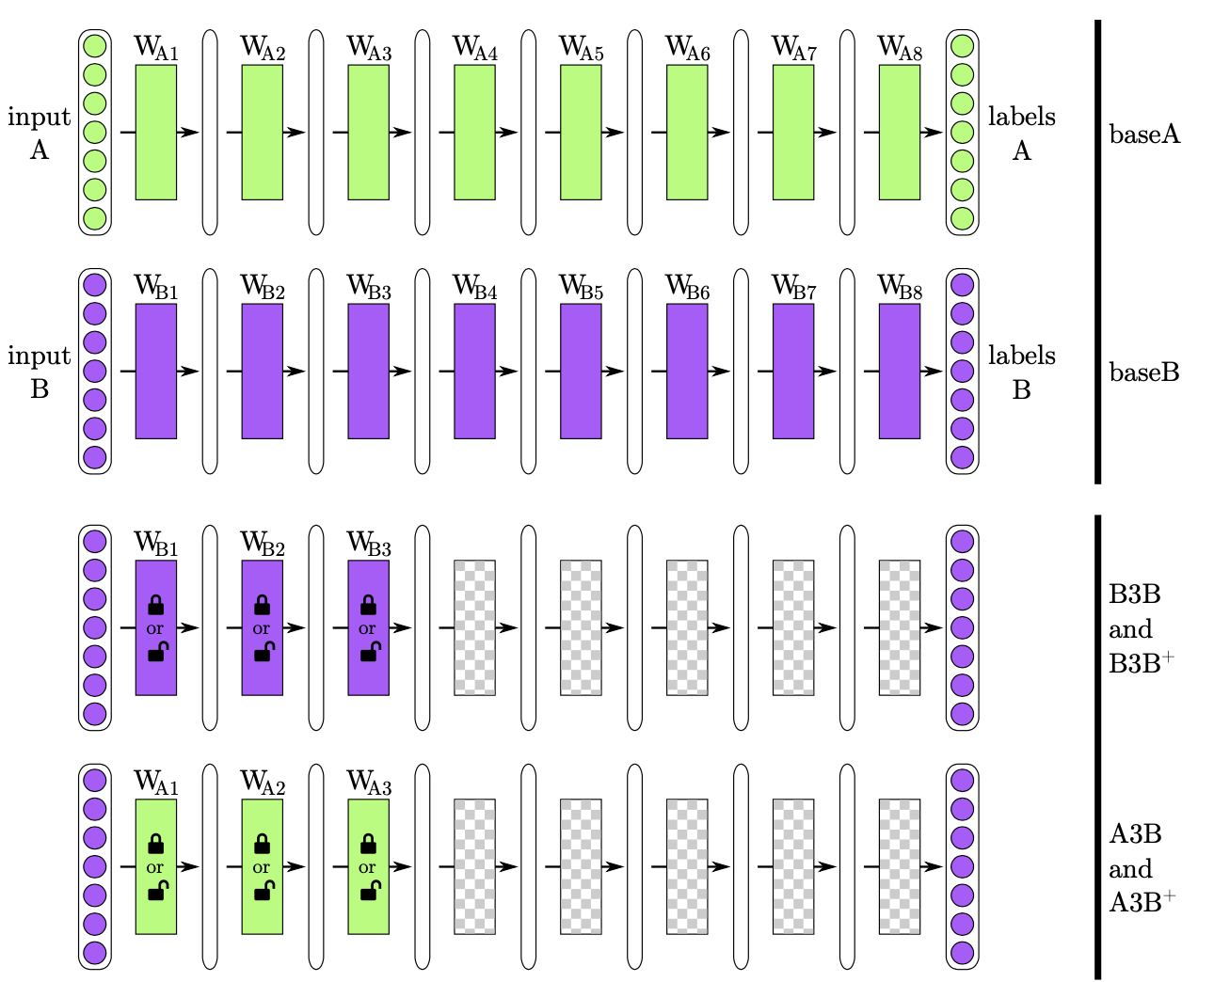
Empirical Studies - Architecture
Jason Yosinski, Jeff Clune, Yoshua Bengio, and Hod Lipson. How transferable are features in deep neural networks? In Advances in neural information processing systems, pages 3320–3328, 2014.
Notes:
1.now talk about..from aspect of arch
2. Earlier studies about visualization of cnn show that, filters learned by low level layers which are close to the input usually produce general features such as.., while high level layers which are close to the output often produce semantic features more related to the final objective.
3. Inspired by these findings, some works try to investigate more properties of different parts of the deep neural network.
4.introduce a work which studies transerability..
5.define a metric to quantify..; metric is ..gap
6.intuitive, if high trans..small drop if fix
7.experiments indicate low layer..high trans..
8.all the layer get better generalization from pretr..

Slide 8
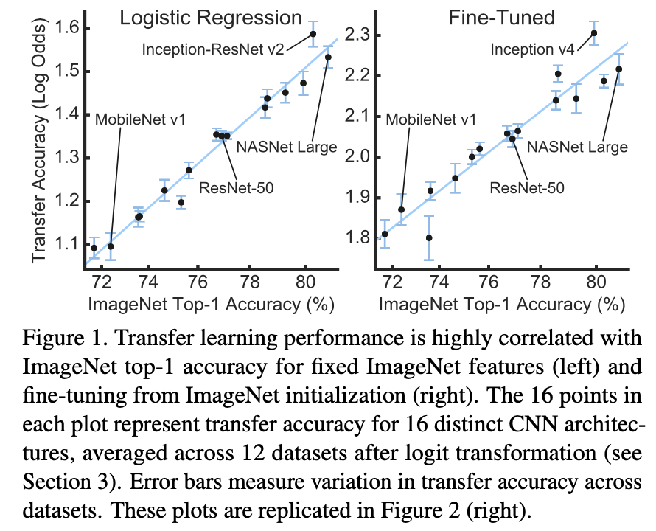
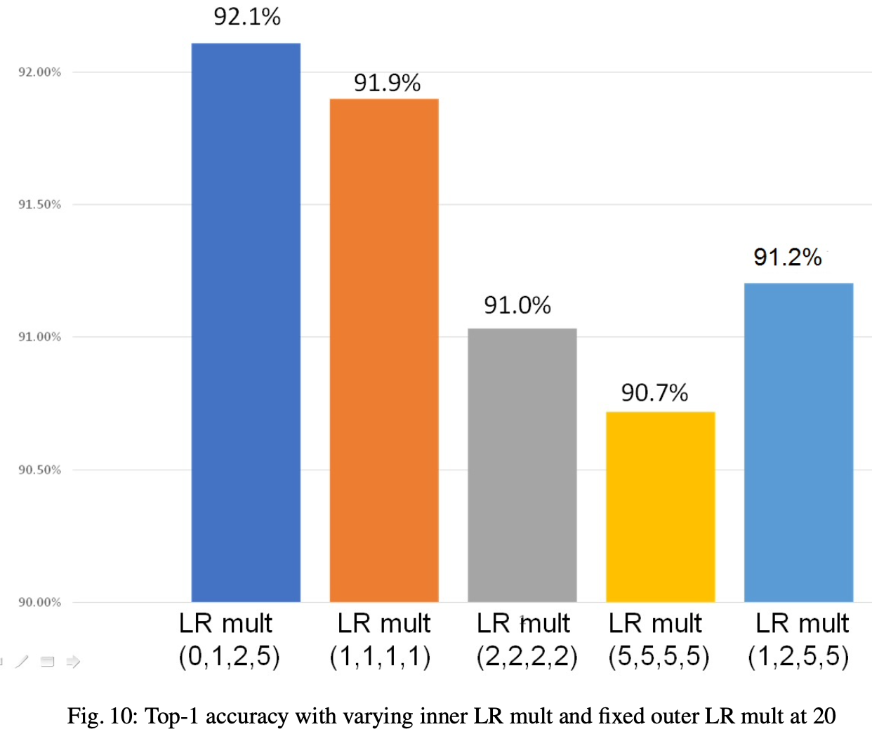
Empirical Studies - Training
Simon Kornblith, Jonathon Shlens, and Quoc V Le. Do better imagenet models transfer better? In Proceedings of the IEEE Conference on Computer Vision and Pattern Recognition, pages 2661–2671, 2019.
Parijat Dube, Bishwaranjan Bhattacharjee, Elisabeth Petit-Bois, and Matthew Hill. Improving transferability of deep neural networks. arXiv preprint arXiv:1807.11459, 2018
Notes:
1.other..from the view point of..; pretrain/fine-tung
2.No novel..empirical instructions for..
[work 1]
3.one investi..whether better imagenet do better in..
4.consistent with common sense..verify hypothesis by..16 arch/12 data
5.left figure; these is strong correlation betw.. with corr..coeff of nearly 1;
[work 2]
6.studies hyper-param influence..; lr important
7.one is num of sample/each class show obvious corre.. of the optimal lr.
8.another graduated lr across layers..right figure

Slide 9
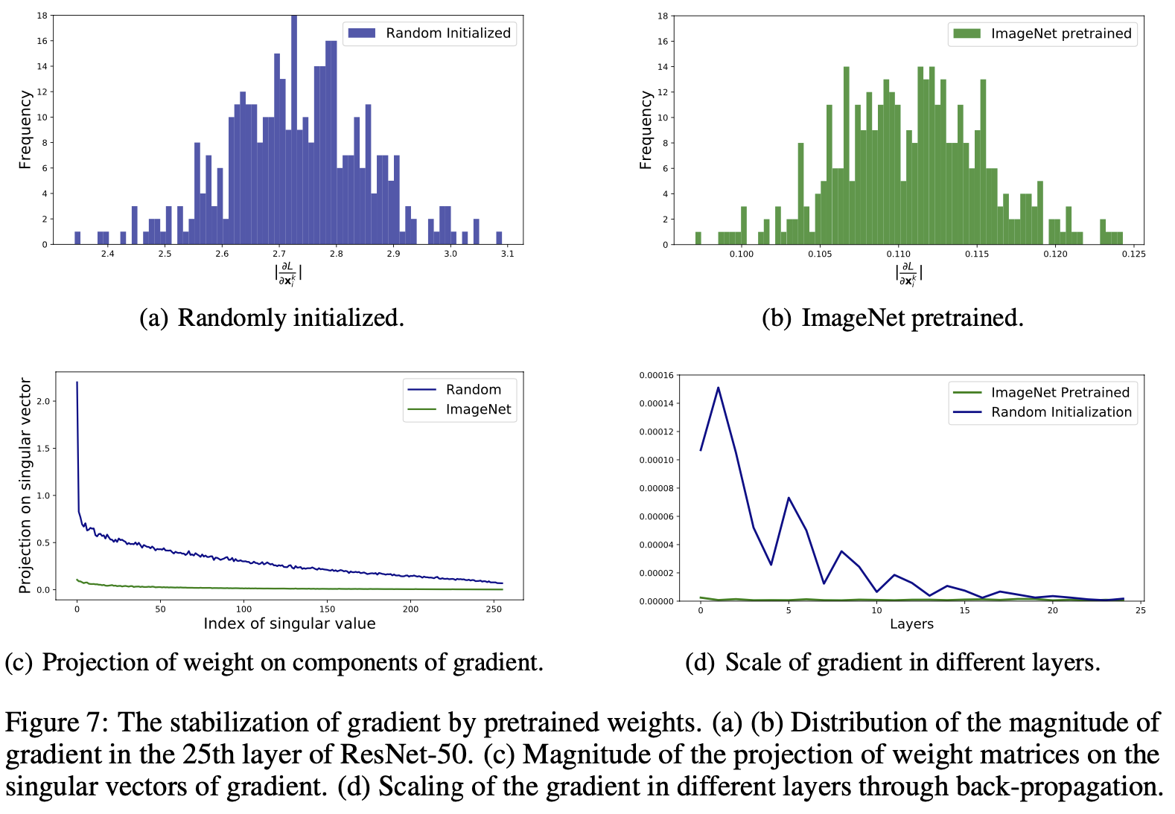
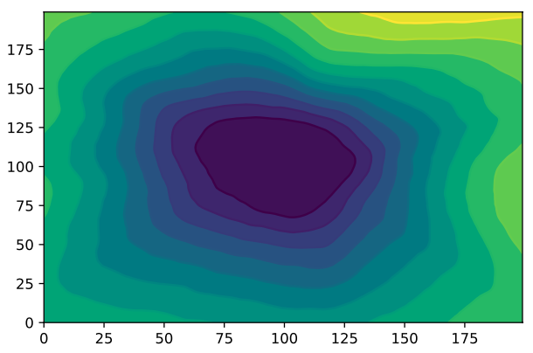
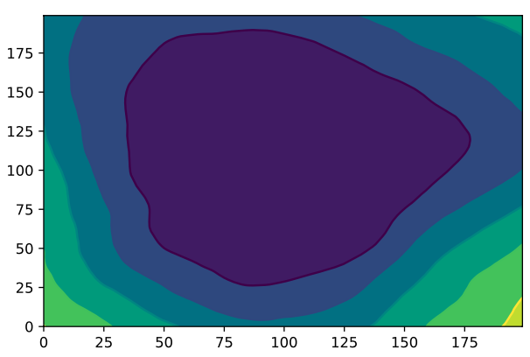
Theoretical Studies - Understanding
Upper: Randomly initialized; Lower: Transfer Learning
Hong Liu, Mingsheng Long, Jianmin Wang, and Michael I Jordan. Towards understanding the transferability of deep representations. arXiv preprint arXiv:1909.12031, 2019.
Notes:
these works aim at theoretically underst.. why ..outperform
Comparing with empirical.. ..much fewer
2. one recent paper indicates that, the reason is solutions fall.. flatter -> indicator of strong gener.. -> verify hypothesis -> one.. observe loss landscape -> left fig -> math -> small eigenvalues -> equals to stable behaviors
3. right figure, different properties of gradient -> stable and small magnitude -> especially lower layer -> suggests that shows less uncertainty

Slide 10
Transfer Learning Algorithms
Data Transfer
Weight Transfer
Feature Transfer
Meta Transfer
Notes:
1.recent algorithms; according to mechanisms..into four categories..which are..
2.for each..introduce 1-2 typical..

Slide 11
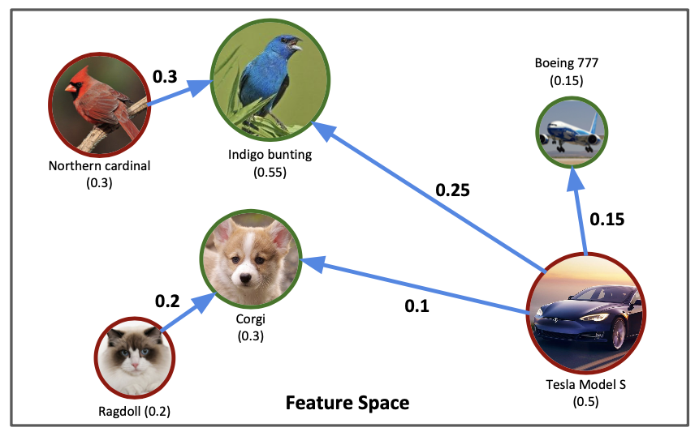
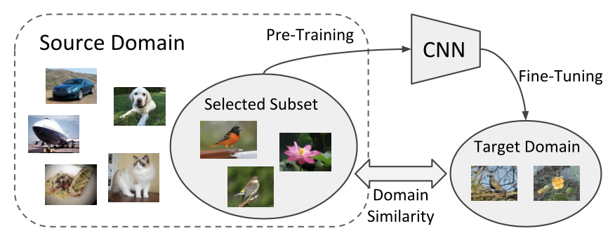
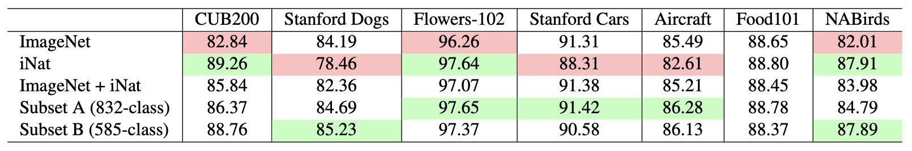
Data Transfer
How to exploit bigger potential of the source dataset ?
Yin Cui, Yang Song, Chen Sun, Andrew Howard, and Serge Belongie. Large scale fine-grained categorization and domain-specific transfer learning. In Proceedings of the IEEE Conference on Computer Vision and Pattern Recognition, pages 4109–4118, 2018.
Notes:
1.first and most straightforward is.. focuses on..
2.one idea..select the optimal subset..instead of..
3.one paper use EarthMoveDist..; The optimal subset for source domain is generated by..
4.in experiments.. two databases(inaturalist)..
5.Inaturalist contains more that half a million images belonging to domains of animals and plants.
6.Notice..both are ..highly biased, as they achieve dramatically different..;
7.An interesting finding.. (1)when we transfer networks trained on the combination of.., perf. are in-between ImageNet and iNat pre-training, (2)indicating that we cannot achieve good perf. by simply using a larger scale, combined source dataset.
8.The effect the proposed method is verified by the selected Subset B. It achieves good perf. among all datasets, and it surpasses ImageNet pre-training by a large margin on CUB200 and NABirds.

Slide 12
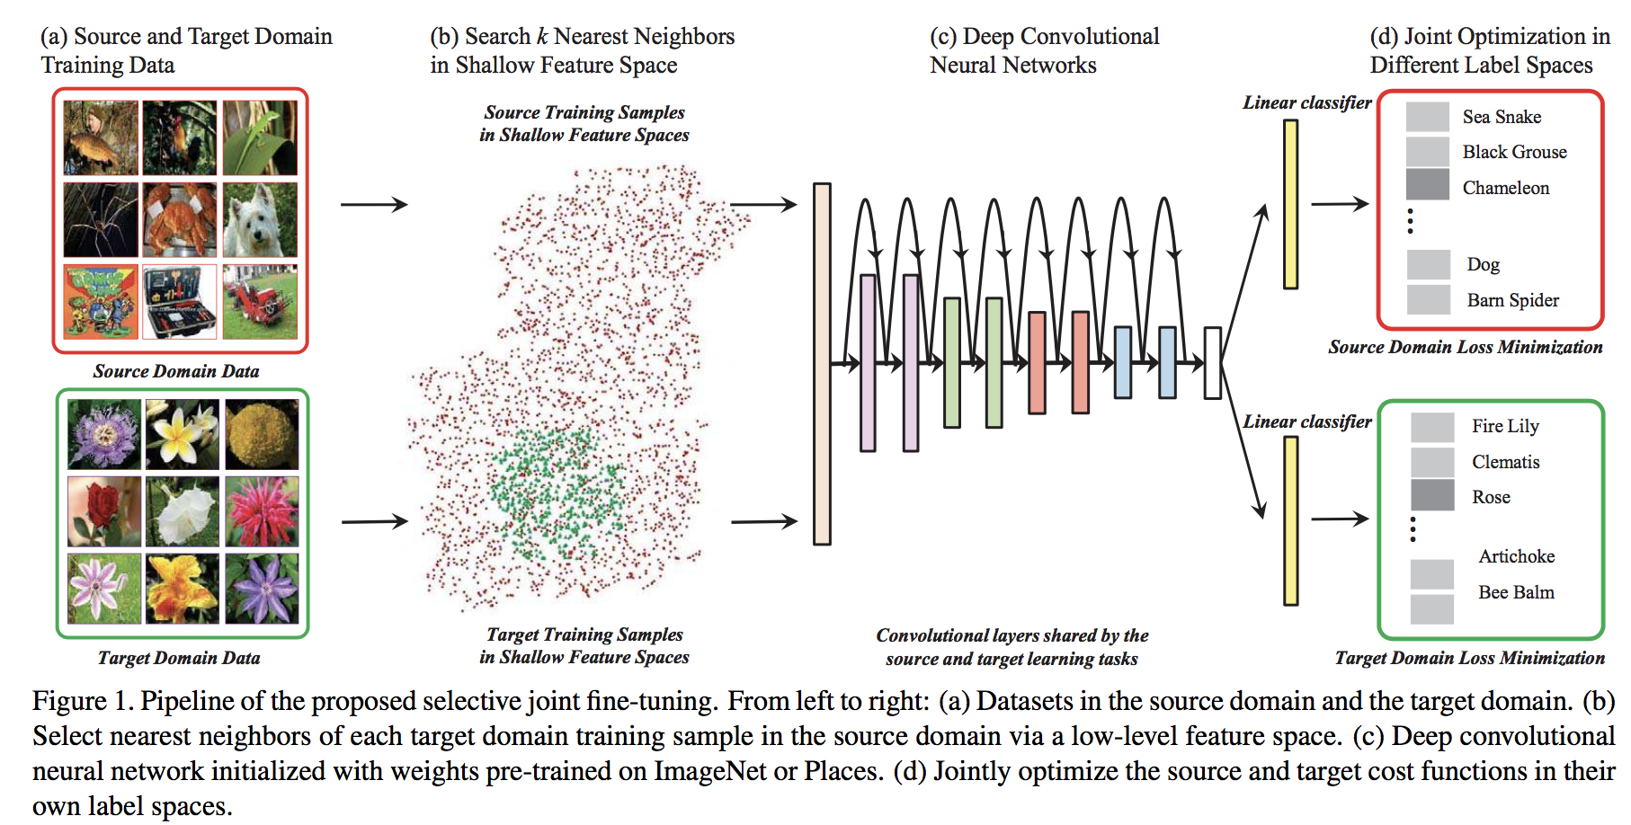
Data Transfer
How to exploit bigger potential of the source dataset ?
Ge W, Yu Y. Borrowing treasures from the wealthy: Deep transfer learning through selective joint fine-tuning
Notes:
1. proposes to borrow
2. similarity
3. multi-task
4.share cnn, separate fc
5.w/o overlapping label spaces
6.difference with method mentioned earlier is

Slide 13
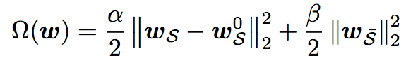
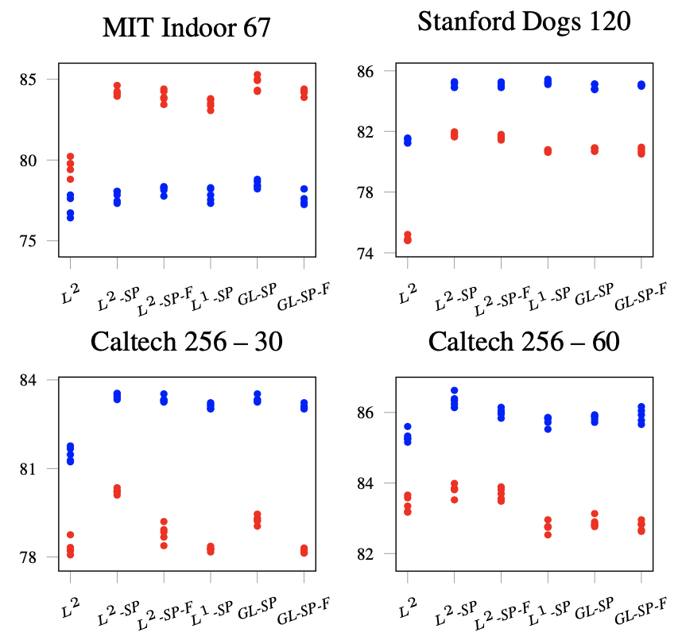
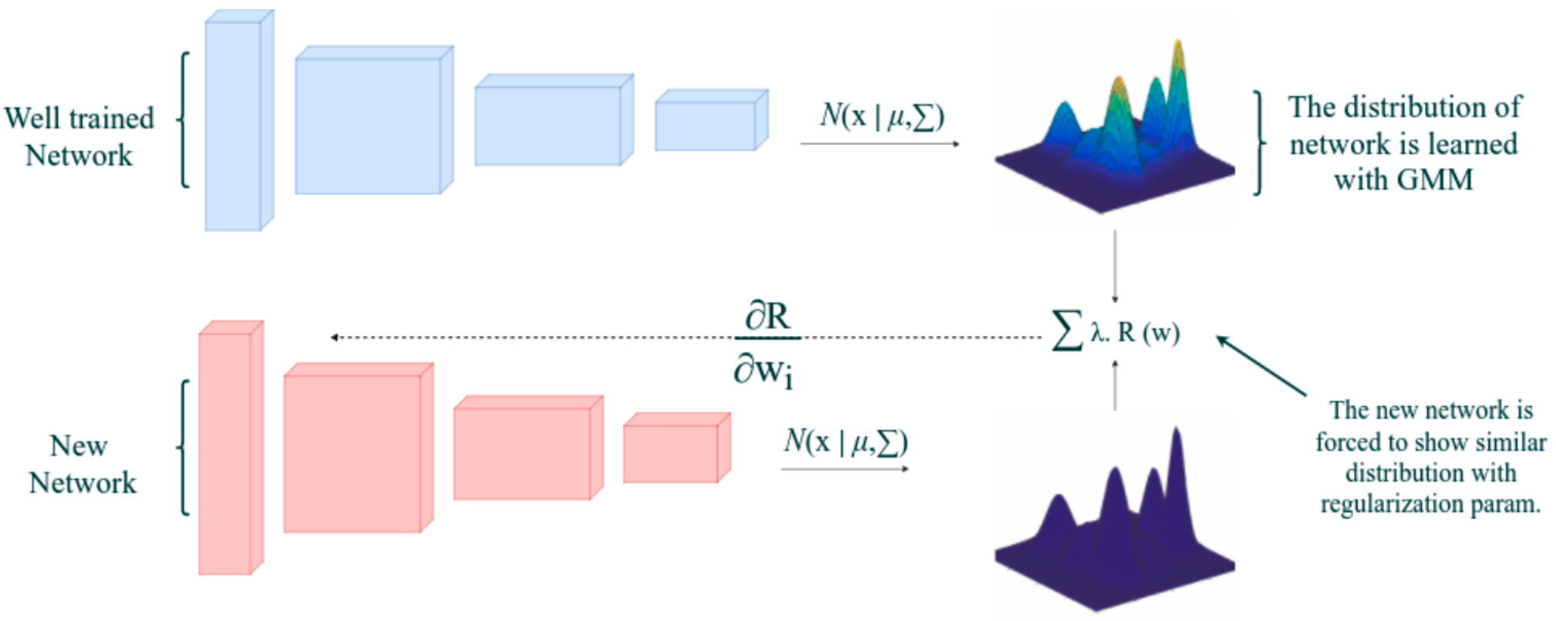
Weight Transfer
How to extract dark knowledge in pre-trained weights
L2-SP
Li X, Grandvalet Y, Davoine F. Explicit inductive bias for transfer learning with convolutional networks
Aygun M, Aytar Y, Kemal Ekenel H. Exploiting convolution filter patterns for transfer learning
Notes:
1. as name suggest -> inves.. kd trans by wei or param
2. SPAR idea -> means constrain ..piror
3. one paper metric..form of L2 -> regularization term to constrain-> exp show SPAR get better..similar -> open a door for further improvement base on SPAR
4. another paper assumes -> means represent kd by distri..

Slide 14
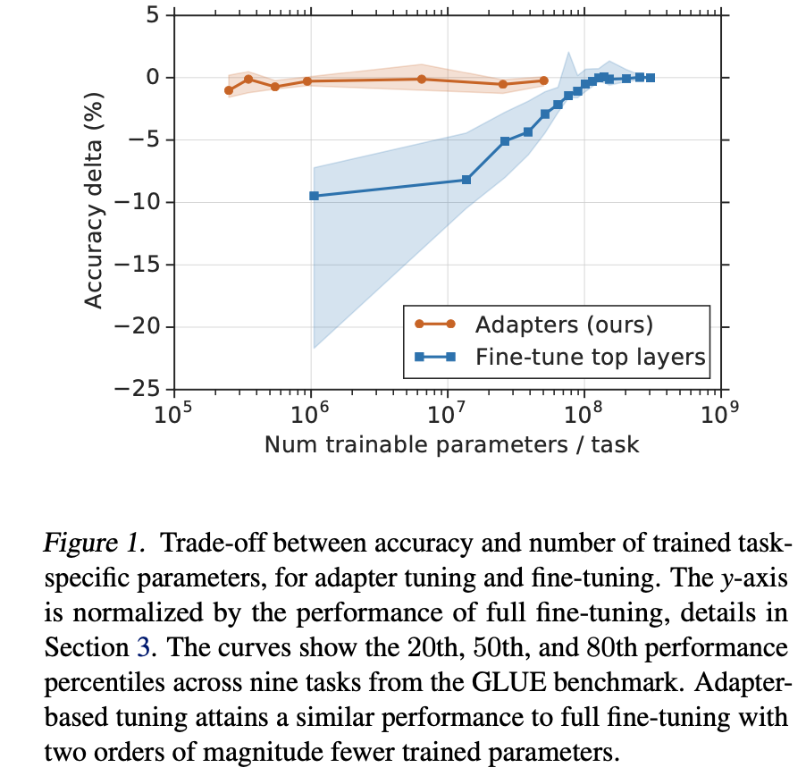
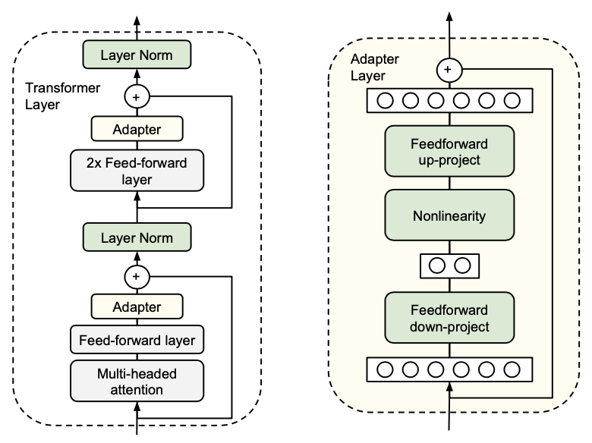
Weight Transfer
Neil Houlsby, Andrei Giurgiu, Stanislaw Jastrzebski, Bruna Morrone, Quentin De Laroussilhe, Andrea Gesmundo, Mona Attariyan, and Syl- vain Gelly. Parameter-efficient transfer learning for nlp. arXiv preprint arXiv:1902.00751, 2019.
Notes:
[idea]
1. Another idea is to transfer with adapter modules.
2. More specifically, we keep the parameters of the original..remaining fixed, and plug in....
3. I regard..as weight transfer..it achieves kd trans through a high degree of parameter sharing.
4. A considerable benefit of this..is that only a few trainable parameters are added, and new tasks can be trained without revisiting previous ones.
[method]
5. One of these works implement a param..effi..for nlp, on transformer based archs.
6. They get a satisfied trade-off between accuracy and the number of trained task-specific parameters.
7. As showed in the figure, this adapter-based.. attains a similar perf. to standard fine-tuning with two orders of magnitude fewer trained parameters.

Slide 15
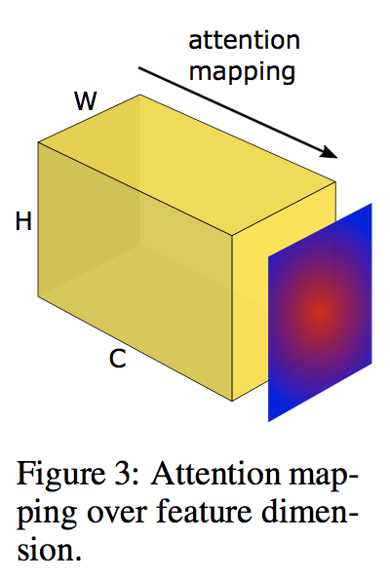
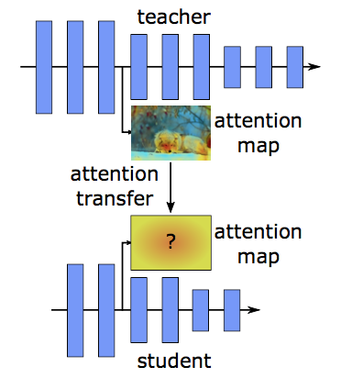
Feature Transfer
Knowledge Distillation on Features
Zagoruyko S, Komodakis N. Paying more attention to attention: Improving the performance of convolutional neural networks via attention transfer
Notes:
1. feature trans shares SPAR.; main diff..; related kd
2. Works of kd have tried ..methods for effective kd transfer from tea to stu.
3. one suggests that the spatial attention map contains valuable info about the network, since it shows where the network focuses in order to classify the given image.
4. They find that the stu..net achieves improved perf. by aligning both activation-based and gradient-based spatial attention maps of the tea..net.

Slide 16
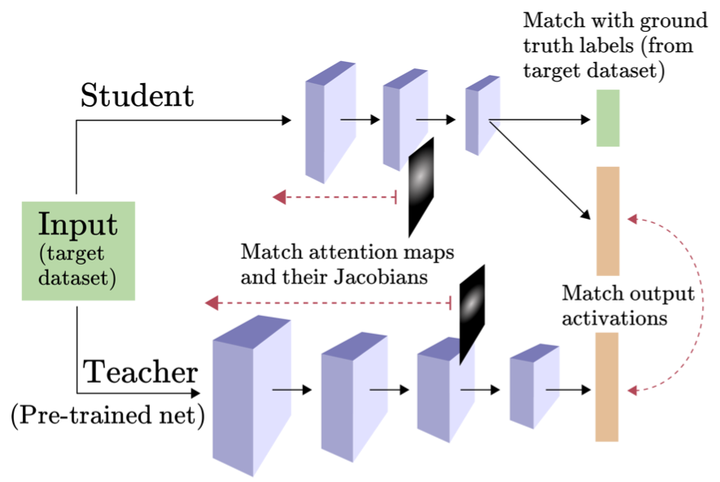
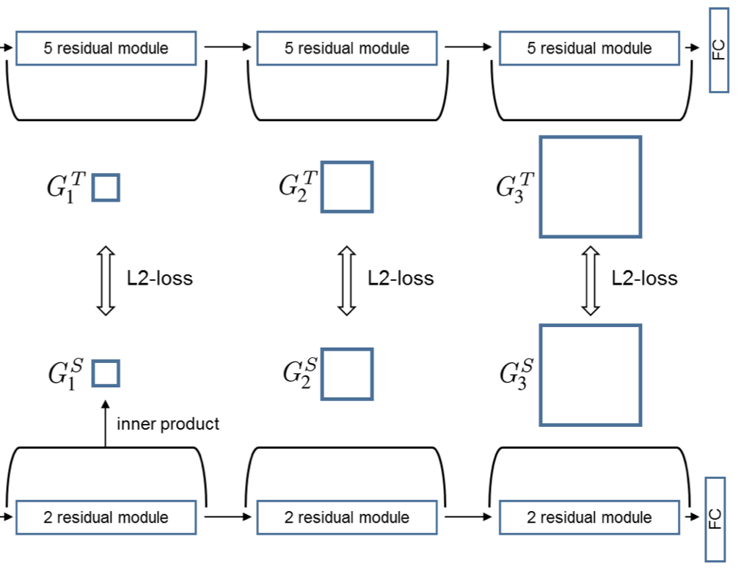
Feature Transfer
Knowledge Distillation on Features
Srinivas S, Fleuret F. Knowledge transfer with jacobian matching
Yim J, Joo D, Bae J, et al. A gift from knowledge distillation: Fast optimization, network minimization and transfer learning
Notes:
1. other propose to align other kinds of info
2. for example, jacobians of the activation maps, or gram matrix across layers. They are regarded as containing important information about the tea..net..
3. as being general kd trans algorithms, their effectiveness is also verified on transfer learning tasks.

Slide 17
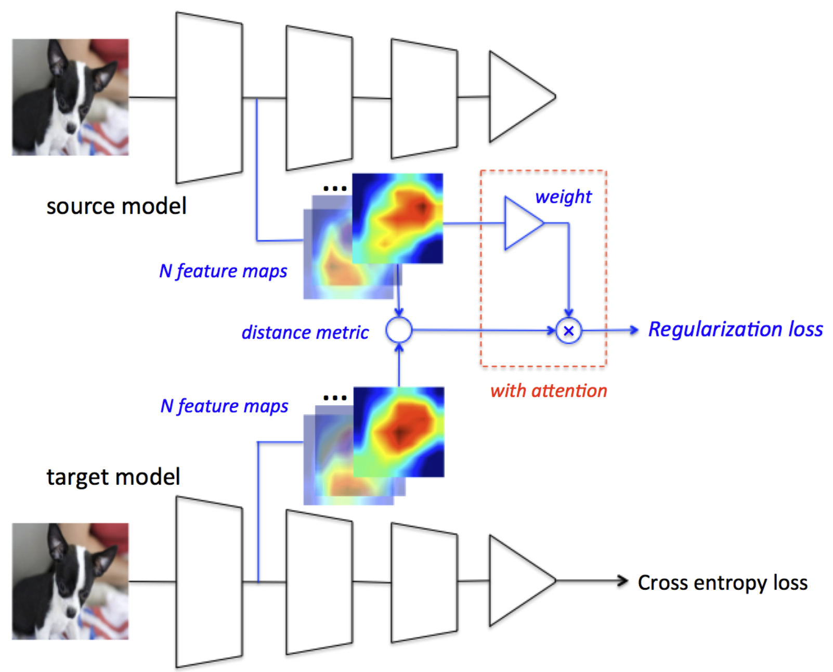
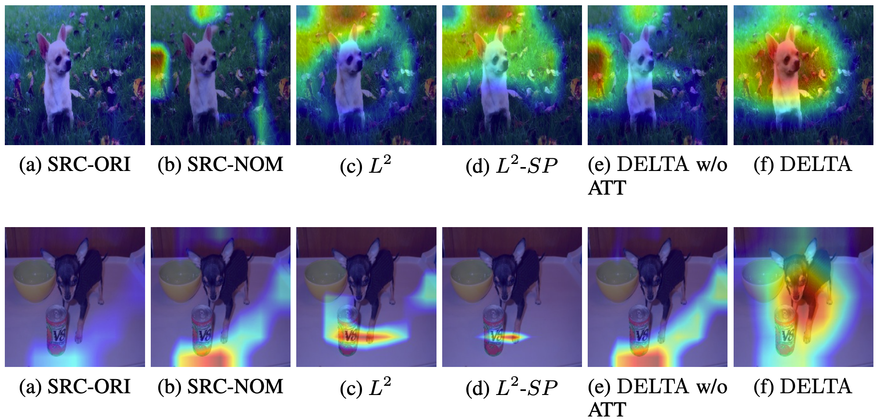
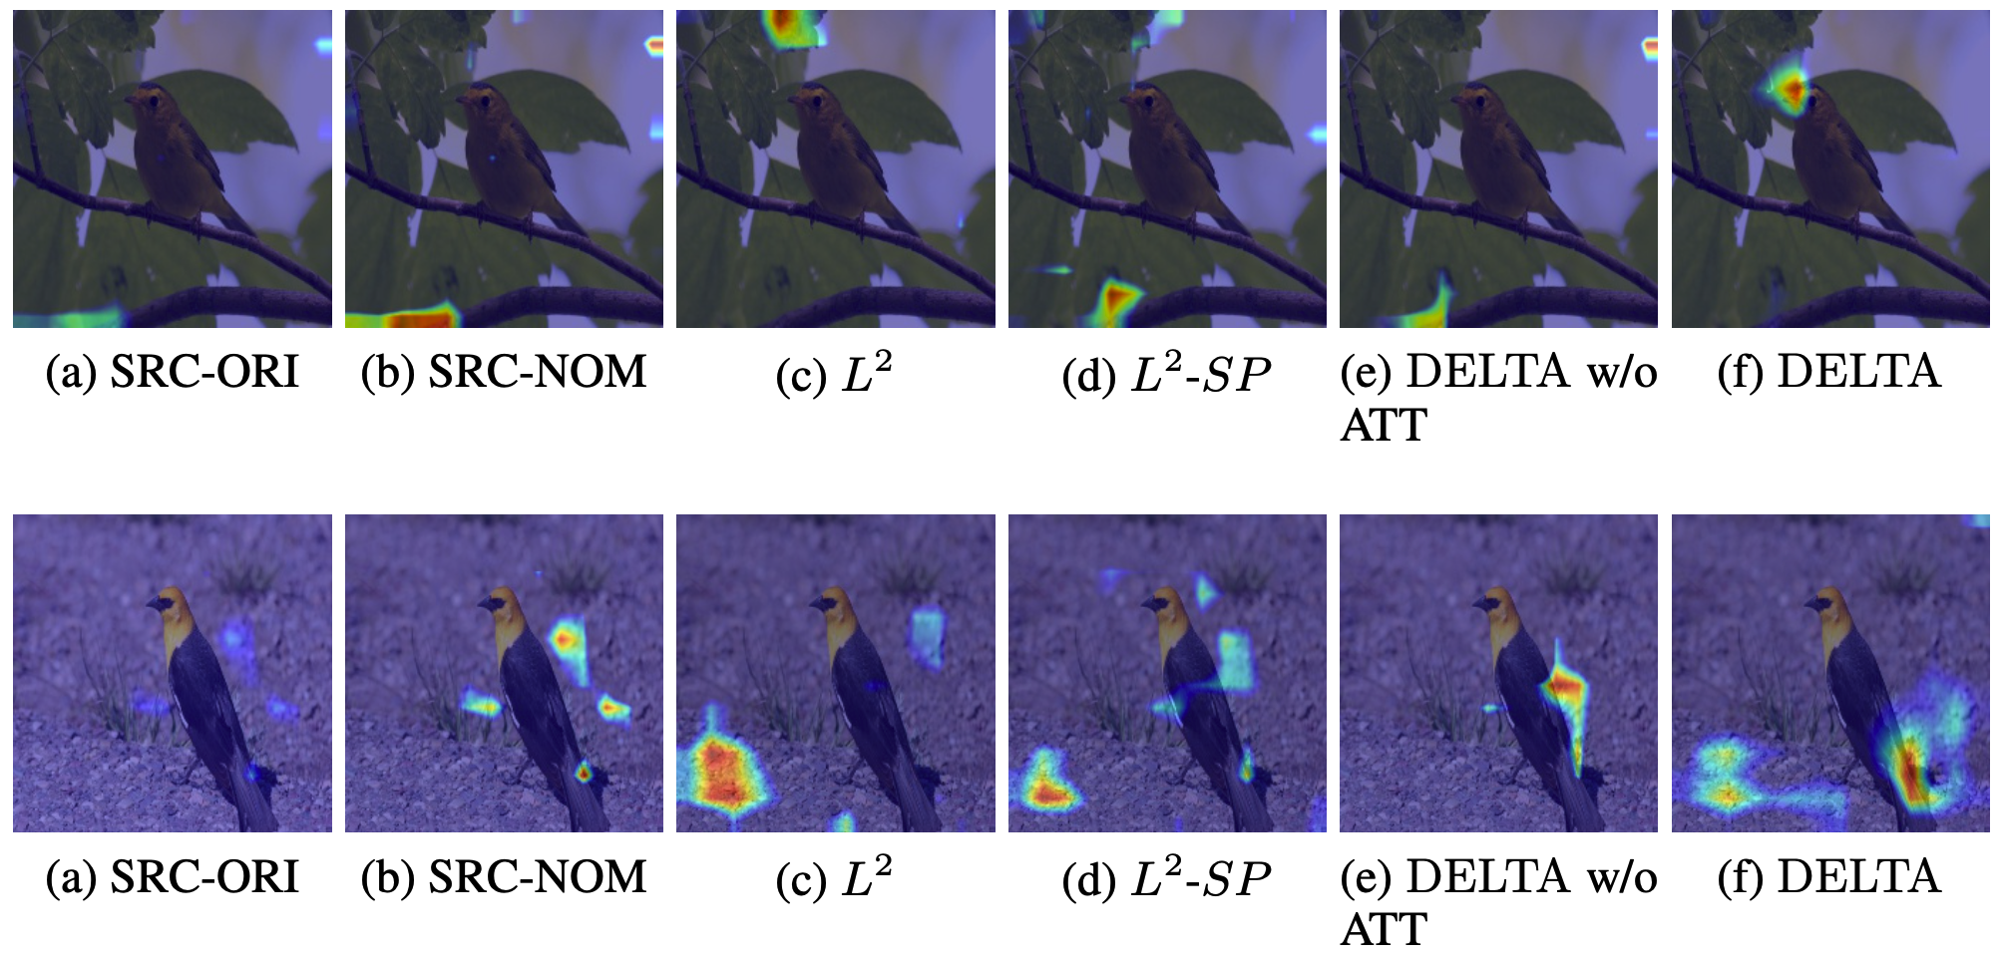
Feature Transfer
Preserving knowledge by middle feature alignment
Xingjian Li, Haoyi Xiong, Hanchao Wang, Yuxuan Rao, Liping Liu, and Jun Huan. DELTA: deep learning transfer using feature map with attention for convolutional networks. International Conference on Learning Representations, 2019.
Notes:
1. A recent paper called deep learning transfer using feature maps with attention, proposes an improved algorithm specific to transfer learning tasks.
2. As general kw trans methods do, it encourages..align middle layer outputs to..src.
3. And to further improve the effect of kw trans, ..imposes the attention mechanism over the channel dimension, to.. irrelevant..relax..freely...
4.(1)This mechanism avoids negative trans to some extend comparing with general kd algo. (2)While comparing with..which seems over-killing, this method gives the parameter more spaces to find the optimal solution. (3)..also achieves faster..than...
5.typical cases are shown..small pictures are..indicating what kinds of patterns..

Slide 18
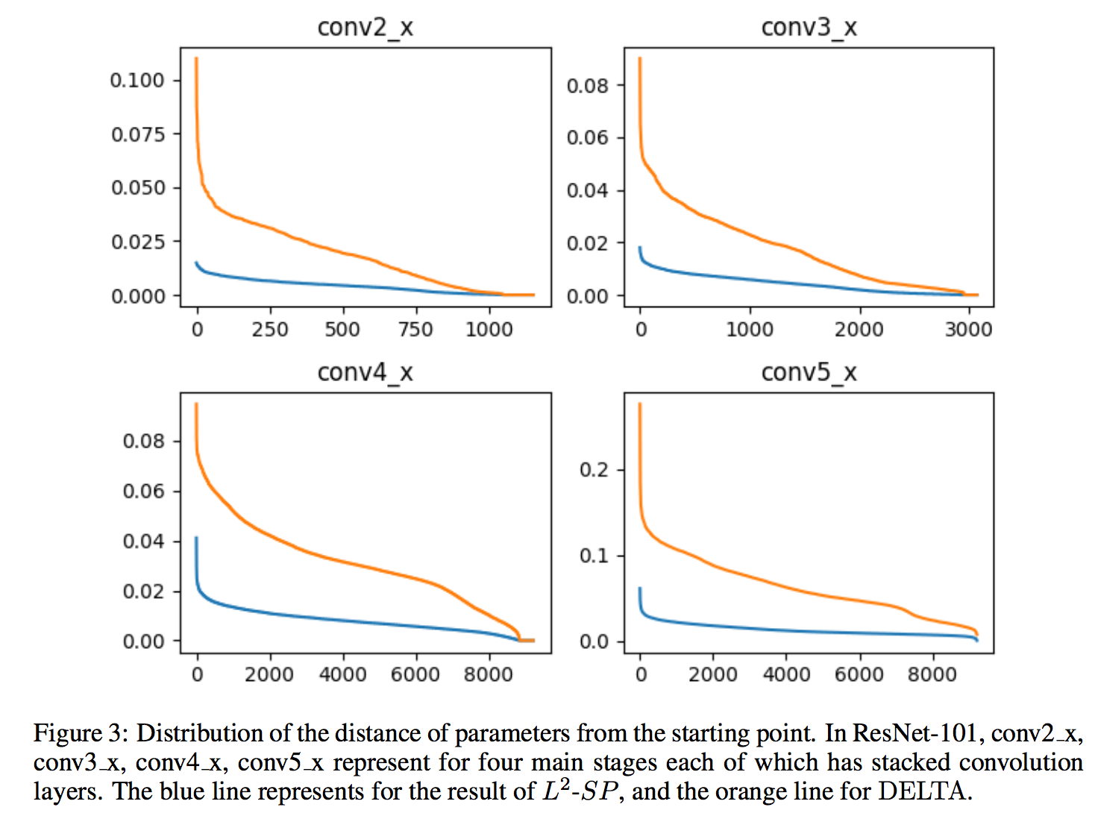
Feature Transfer
Effect of “unactivated channel re-usage”
Discussion
About 90% parameter vectors of DELTA have larger distance from the stating point than L2-SP, and a small number of filters is driven very far away from the initial value (as shown at the left end of the curves in Figure 3).
Using attention, we allow “unactivated” convolution filters to be re-used for better image classification.
Notes:
1.give a brief disuss about the effect..
2.left figure, most of..params..of..have larger.., and a small..
3.This observation verifies the hypothesis that some useless features are relaxed and freely learn from the target task, escaping from the negative constraining of the source model.

Slide 19
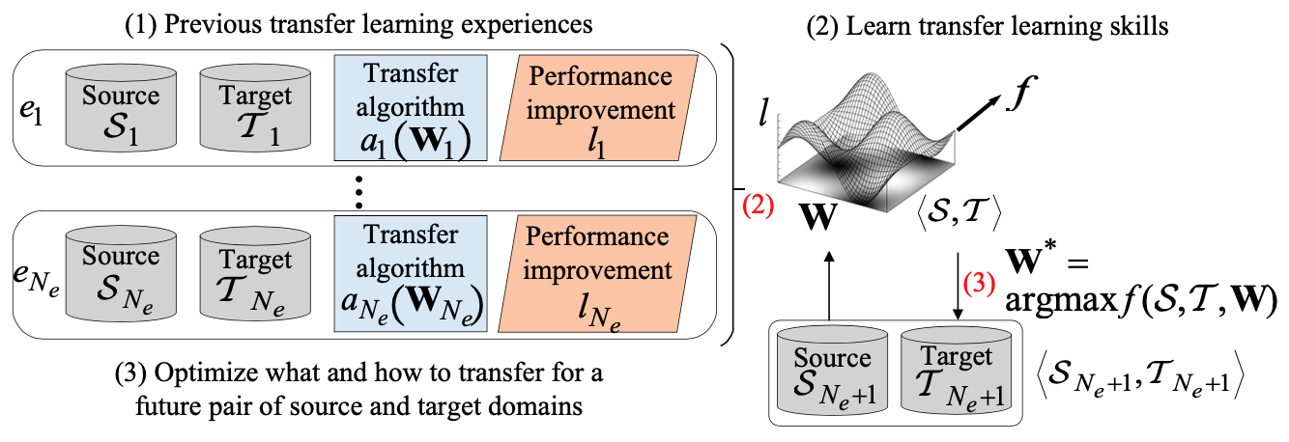
Meta Transfer
Learning to choose algorithms based on historical experiences
Ying, W., Zhang, Y., Huang, J., & Yang, Q. Transfer learning via learning to transfer
Notes:
1. last category..borrows the basic idea of meta lea..
2. meta learning is ..different paradigm representing.. 3. For example, normal learning of image classification task..while..
4. Specifically, the input..output..any indicator.
5. One paper verifies this idea in a simple transfer learning framework. The main process..is demonstrated..
6. They first...and ..two properties as..(1)diff between src/tgt domain. (2)discriminative ability of tgt.
7. Then a model is trained to learn ...in other words, it learns to predict the performance given the algorithm and above features as input.
8. At test time, given a new pair of src/tgt task, we just solve the optimal trans..algorithm by maximizing the output of perf.

Slide 20
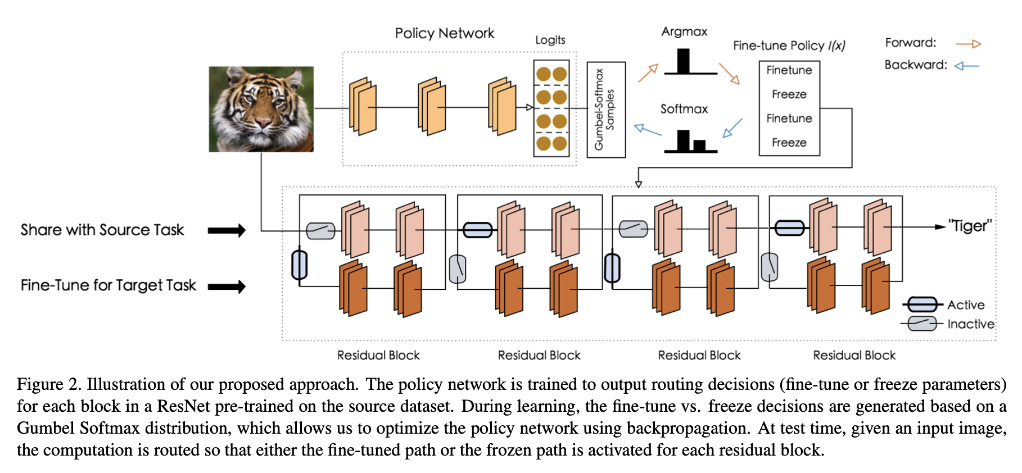
Meta Transfer
Learning to adapt algorithms based on historical training steps
Yunhui Guo, Honghui Shi, Abhishek Kumar, Kristen Grauman, Tajana Rosing, and Rogerio Feris. Spottune: transfer learning through adaptive fine-tuning. In Proceedings of the IEEE Conference on Computer Vision and Pattern Recognition, pages 4805–4814, 2019.
Notes:
1. Another idea ..is..
2. A typical work is illustrated..
3. In this work, the exactly meaning of adapt is to decide whether to fine-tune/freeze some layer.
4. after obtaining the model pretrained on src, they impose a policy network to output routing decisions for each block.
5. During learning, the decisions of whether to fine-tune or freeze are generated based on a Gumbel Softmax distribution, which allows us to optimize the policy network using backpropagation.
3. At test time, given an input image, the computation is routed so that either the fine-tuned path or frozen path is activated for each residual block.

Slide 21
AutoDL Transfer Application
AutoDL Transfer has been used in multiple Baidu products and services
Over 1 million calls per month
EasyDL
http://ai.baidu.com/ezdl/
AIStudio
http://aistudio.baidu.com
Jarvis
http://di.baidu.com/product/jarvis?castk=LTE%3D#solution-sec0
Baidu Cloud ML
https://console.bce.baidu.com/bml/#/bml/autoDL
Notes:
1. In following parts, I'm going to briefly introduce the applications of autodl transfer.
2. Now autodl transfer has been used...including EasyDL..
3. Every month, autodl transfer serves over 1 millon inference requests through interfaces of Baidu's AI products.

Slide 22
AutoDL Transfer Application
AutoDL-Transfer achieves significant improvements on numerous real world projects
Baseline：Inception v3+Fine-tuning
AutoDL Static Model：AutoDL searches a model architecture from one dataset and then directly use it on another dataset
AutoDL Dynamic Model：AutoDL searches the best model on each dataset
Notes:
[ˈnjuːmərəs]
1.achieves... without manually tuning hyper-parameters.

Slide 23
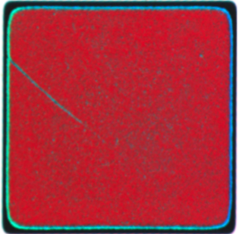
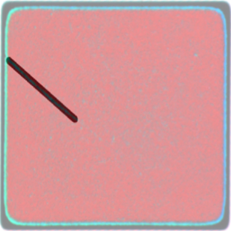
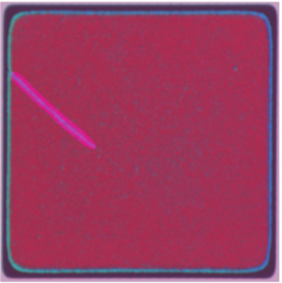
AutoDL Application I: Semantic Analysis
Industrial production: Products defects labeling (Semantic analysis task)
AutoDL improves mean IOU from 0.66 to 0.69
Original Sample
Labeled by Human
Labeled by AutoDL
Notes:
We have applied autodl to indus..

Slide 24
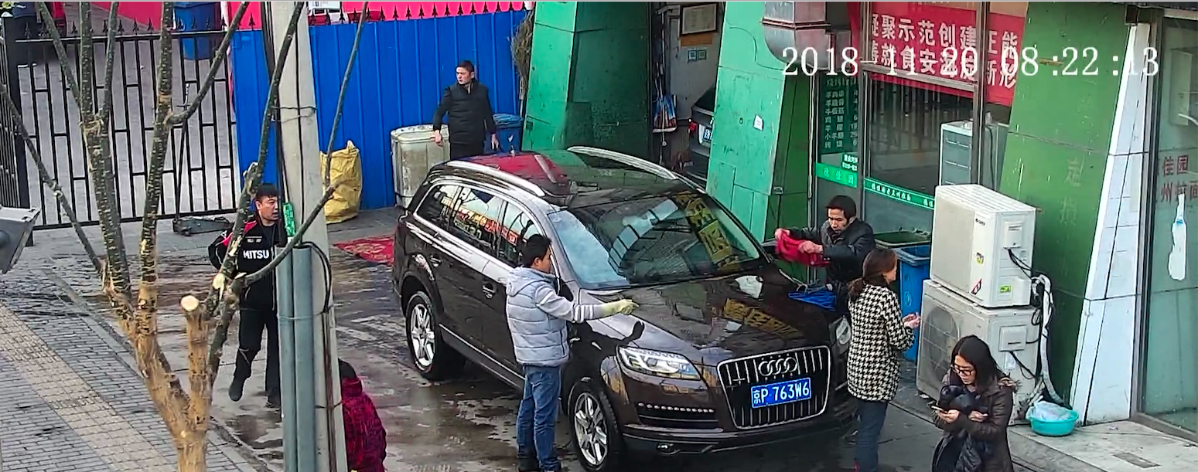
AutoDL Application II Object Detection
Smart City: Identify improperly disposed items (Object Detection)
AutoDL improves model’s mAP from 0.41 to 0.48
Notes:
AutoDL is also used to help build the smart city. One example is the object detection task of identifying.. AutoDL ..

Slide 25
AutoDL Applicaiton III ：Fine-tuning Hyperparameters in NLP Transfer Learning
AutoDL Finetuner
Used for transfer learning tasks, where the fine-tuning of 12 sets of crucial hyperparameters is automated
Based on Baidu’s Blackbox optimization algorithm P-SHE2[1], and already made available on Padddle Hub
Sentimental Analysis in Chinese | Precision | Resources Needed
Fine-tuning by Human Experts | 95.4% | -
Random Search | 94.9% | 40 GPU Hours
AutoDL Finetuner | 95.2% | 40 GPU Hours
1. Gradient-Free Learning with a Continuous-time Approach, under review
Notes:
1. We implement AutoDL fine-tuning, for automated and effective fine-tuning.
2. We verify the algorithm in nlp tasks. 12 sets of crucial hyperparameters are automated decided, based on Baidu's blackbox optimization algorithm P-SHE2.
3. AutoDL fine-tuning obtains precision very close to human experts, in the condition of acceptable resource consumption.
4. The code of AutoDL fine-tuning is avaoliable on Paddle Hub.

Slide 26
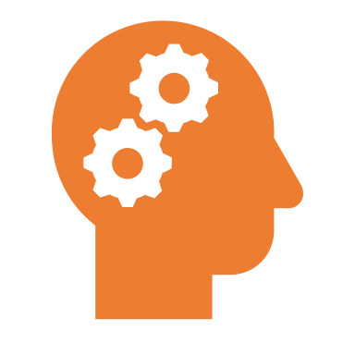







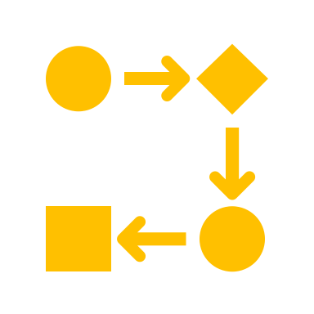





AutoDL Application IV： In Structured Data
GPU
CPU
Human Experience
Data Pre-processing and Encoding
Feature Engineering
Model Selection
Data Input
Automated Fine-tuning throughout the Process
Model Output
Automated fine-tuning throughout the process
Supports 48 types of common data pre-processing methods
Case Study: A client used AutoDL on a loan risk control model, whose AUC was improved from 0.6265 to 0.6504
Notes:
1. we also apply autodl to tasks with structured data
2. it supports 48 types of common data pre-processing methods.

Slide 27
Thank you
For more information:
Dr. Dejing Dou, Head of Big Data Lab, Baidu Research
Email: doudejing@baidu.com

